Slide 1
Analysis on the English Premier League
Brian Witarsa

Slide 2
Main Questions
Which metrics are the best indicators of success?
Which team will win the English Premier League according to the best metrics?

Slide 3
Process
Extract
Filter
Merge
Identify top metrics
Visualize Results
Final Prediction

Slide 4
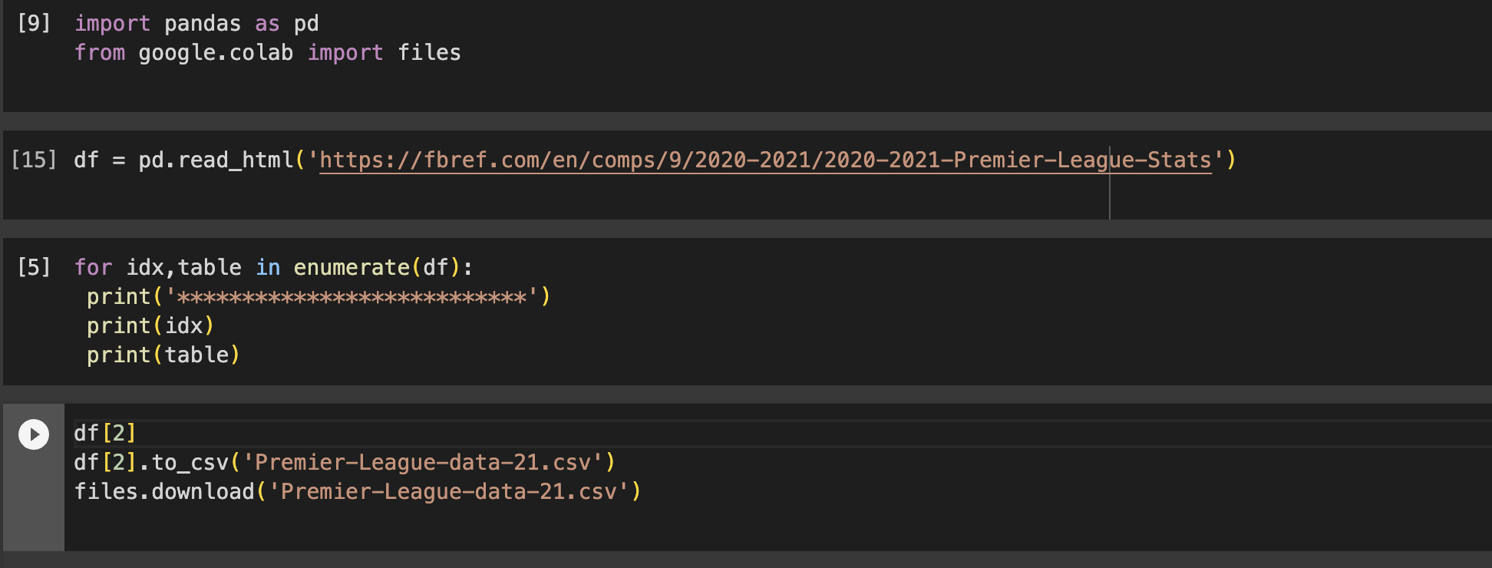
Extract Data

Slide 5
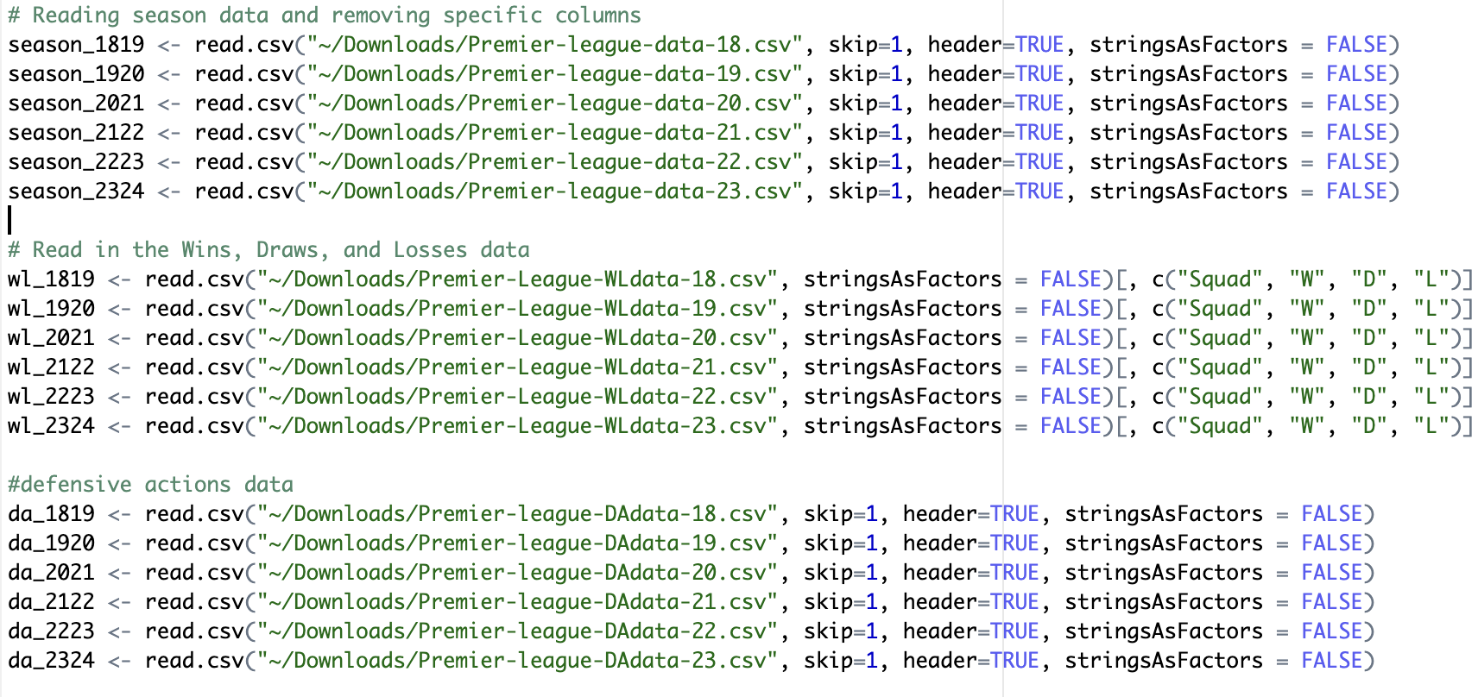
Filter

Slide 6
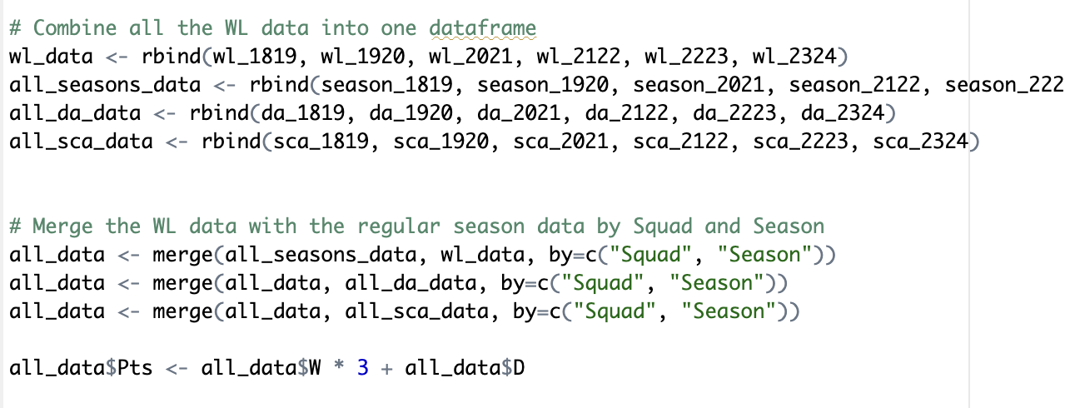
Merge

Slide 7
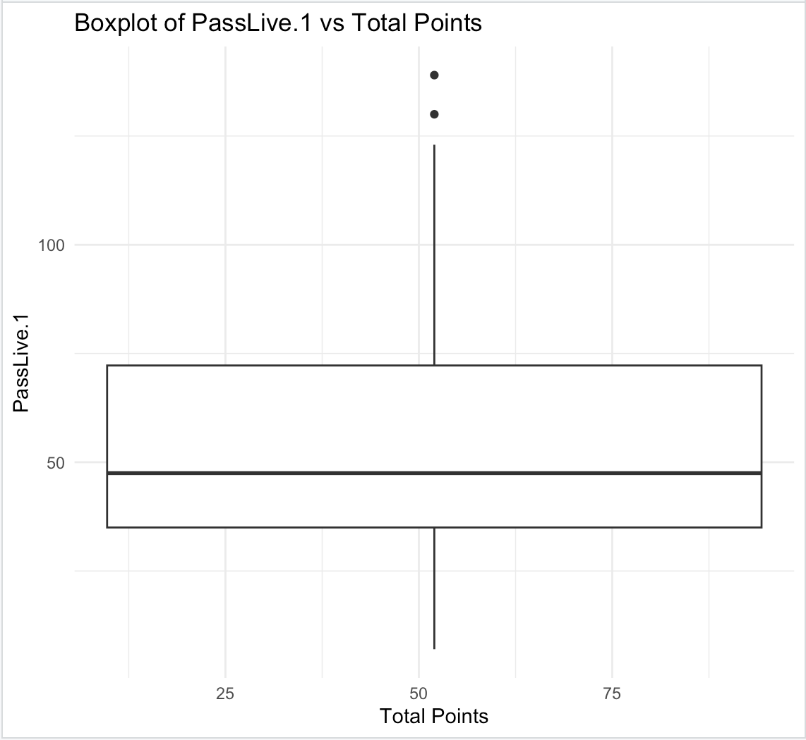
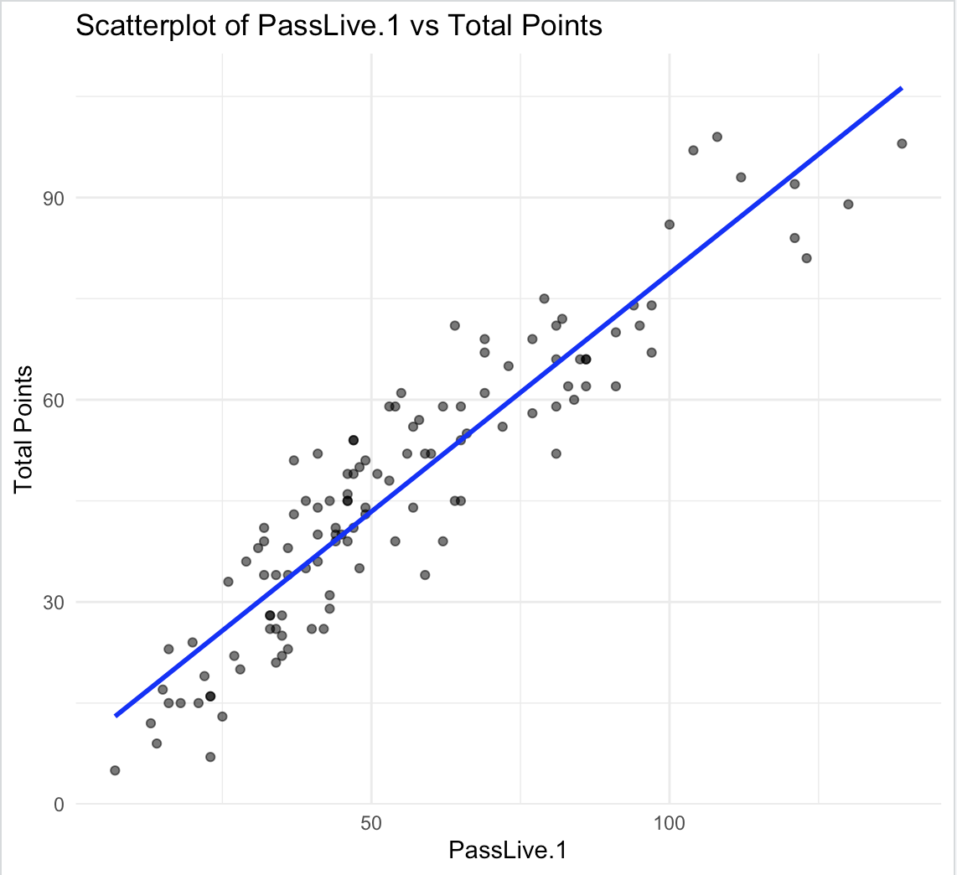
Visualizing results
Correlation analysis
Bar plot
Boxplots
Scatterplots

Slide 8
What metrics are the best indicators of success?
Wins
Goals per 90
Goal Creating Actions: Goal Creating Actions (GCA) and Shot Creating Actions (SCA), meaning the two offensive leading to a shot or goal. This includes live-ball passes, dead-ball passes, successful dribbles, shots which lead to another shot, and being fouled.
Goals and Assists per 90
Non penalty Goals per 90
Live Passes: completed live ball passes that led to a shot attempt
Assists
Expected Goals
Non-penalty expected goals
Non-penalty expected goals and assists

Slide 9
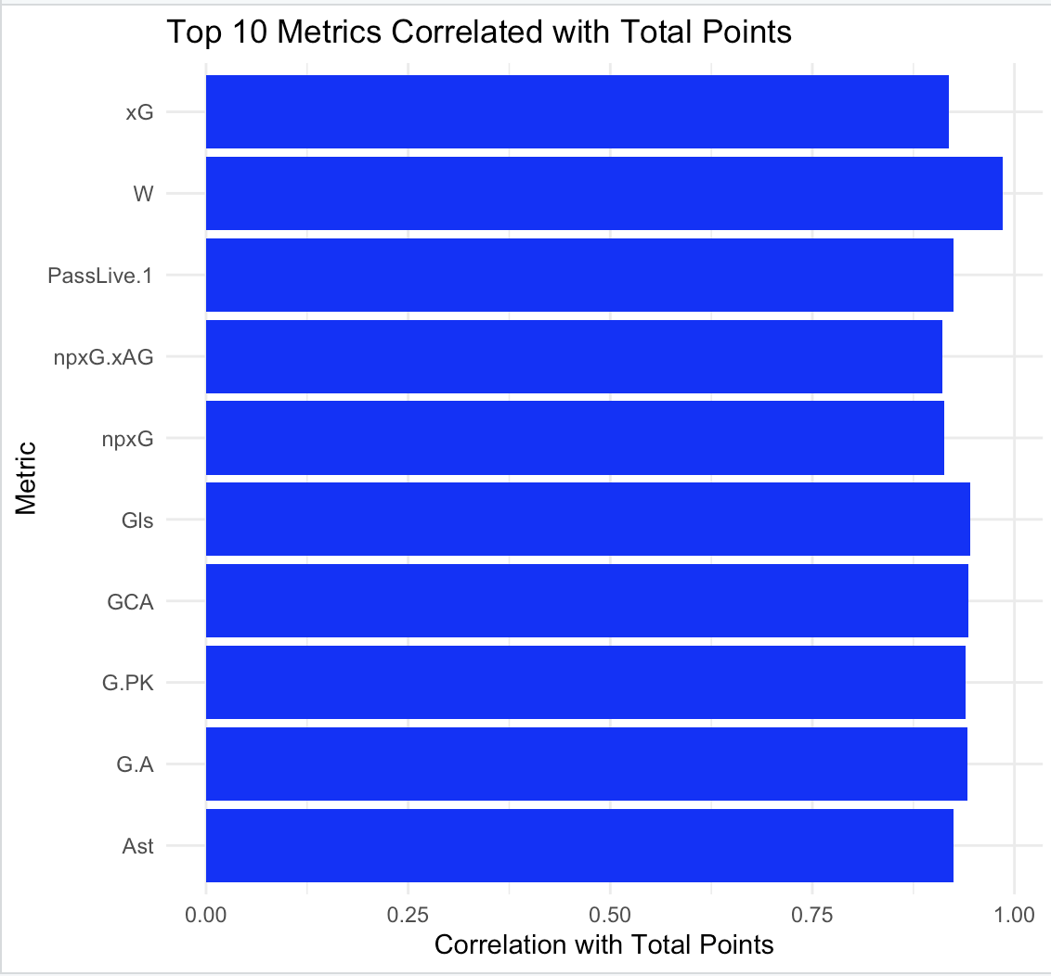
Best Metrics

Slide 10
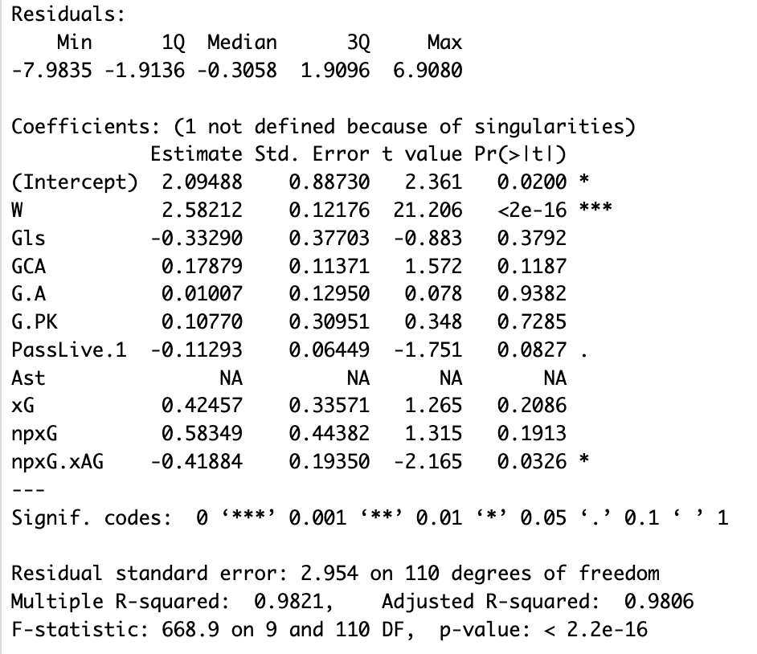
Prediction
Multiple regression model
Estimate: represents the estimated change in the total points (dependent variable) for a one-unit change in the respective independent variable, with all other variables constant.
W and npxG. xAG p values are < 0.05

Slide 11
According to the metrics, which team is predicted to win this season?
Past 6 winners of the Premier League
18/19: Manchester City
19/20: *Liverpool
20/21: Manchester City
21/22: *Manchester City
22/23: Manchester City
Predicted Winners
18/19: Manchester City
19/20: *Manchester City
20/21: Manchester City
21/22: *Liverpool
22/23: Manchester City
23/24 Premier League Winners: Manchester City

